Slide 1
Consumer Goods Ad_Hoc Insights
Presented By Neethu Santhosh Kumar

Slide 2
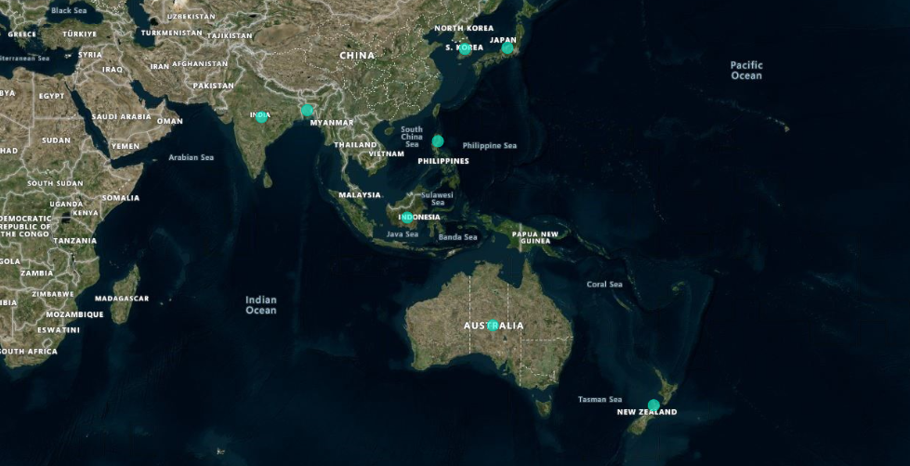

1.Provide the list of markets in which customer "Atliq Exclusive" operates its business in the APAC region.
select distinct market
from dim_customer
where
customer = 'Atliq Exclusive’
and
region = 'APAC’
order by market;

Slide 3
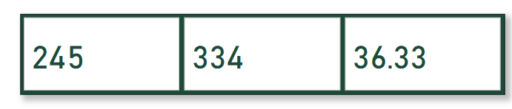
2. What is the percentage of unique product increase in 2021 vs. 2020? The final output contains these fields, unique_products_2020 unique_products_2021 percentage_chg
with unique_products_2020 as
(
select count(distinct product_code) as unique_products_2020
from fact_gross_price
where fiscal_year=2020
),
unique_products_2021 as
(
select count(distinct product_code) as unique_products_2021
from fact_gross_price
where fiscal_year=2021
)
Select
up20.unique_products_2020,
up21.unique_products_2021 ,
Round(((unique_products_2021- unique_products_2020)
*100)/unique_products_2020,2)
as percentage_chg
from unique_products_2020 up20,
unique_products_2021 up21;
unique_products_2020
unique_products_2021
Percentage change

Slide 4
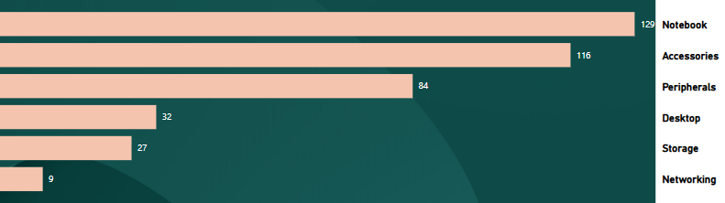
3. Provide a report with all the unique product counts for each segment and sort them in descending order of product counts. The final output contains 2 fields, segment product_count
Unique Product
Segment
Select segment,
count(distinct product_code)
as product_count
from dim_product
group by segment
order by product_count desc;

Slide 5
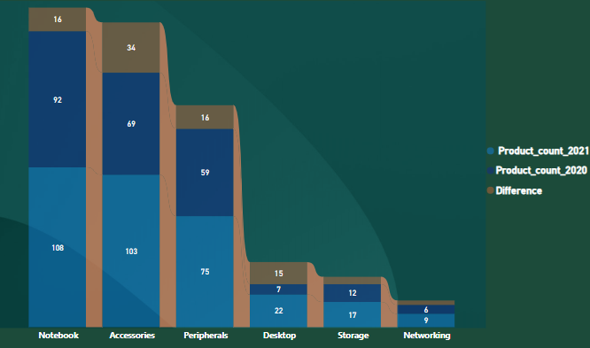
4. Follow-up: Which segment had the most increase in unique products in 2021 vs 2020? The final output contains these fields,
segment, product_count_2020 ,product_count_2021 difference
with sf as
(
select p.product_code,p.segment,f.fiscal_year
from dim_product as p
join fact_sales_monthly as f on p.product_code=f.product_code
)
select segment,
count(distinct case when fiscal_year ='2020' then product_code end)as product_count_2020,
count(distinct case when fiscal_year ='2021' then product_code end)as product_count_2021,
count(distinct case when fiscal_year = '2021' then product_code end) - count(distinct case when fiscal_year = '2020' then product_code end)
as difference from sf
group by segment
order by difference desc;

Slide 6
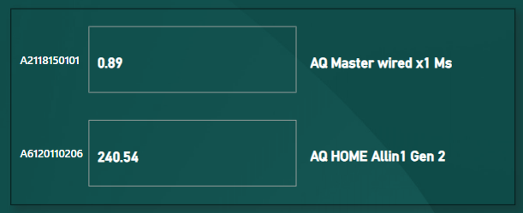
5. Get the products that have the highest and lowest manufacturing costs. The final output should contain these fields, product_code product manufacturing_cost
select m.product_code,p.product,m.manufacturing_cost
from fact_manufacturing_cost as m
join dim_product as p on m.product_code=p.product_code
where m.manufacturing_cost=
(select min(manufacturing_cost) from fact_manufacturing_cost) or m.manufacturing_cost=
(select max(manufacturing_cost)from fact_manufacturing_cost)
order by manufacturing_cost desc;
Products having highest and lowest manufacturing cost

Slide 7
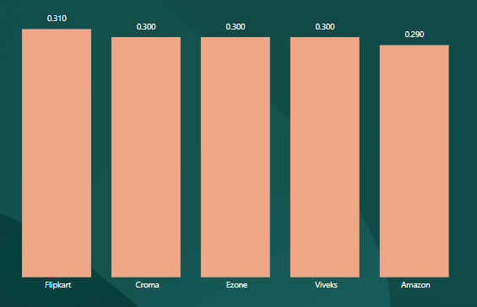
6. Generate a report which contains the top 5 customers who received an average high pre_invoice_discount_pct for the fiscal year 2021 and in the Indian market. The final output contains these fields, customer_code customer average_discount_percentage
with piv as
(
select f.fiscal_year,f.pre_invoice_discount_pct,
f.customer_code,c.customer,c.market
from fact_pre_invoice_deductions f join dim_customer c on f.customer_code=c.customer_code
where fiscal_year='2021' and market='India’ ),
avg1 as
(
select customer_code,customer,
round(avg(pre_invoice_discount_pct),2) as average_discount_percentage
from piv
group by customer_code,customer )
select customer_code,customer,
average_discount_percentage
from avg1
order by average_discount_percentage desc limit 5;

Slide 8
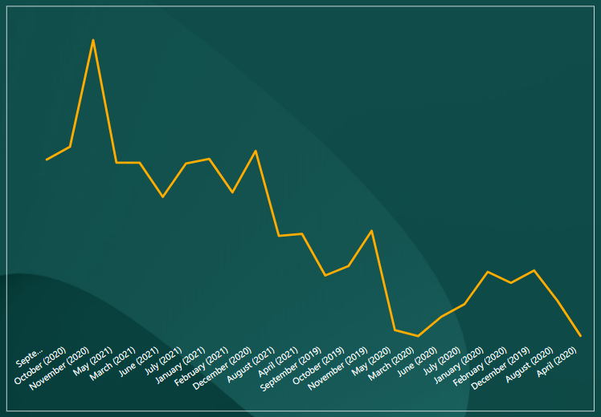
7.Get the complete report of the Gross sales amount for the customer “Atliq Exclusive” for each month. This analysis helps to get an idea of low and high-performing months and take strategic decisions.The final report contains these columns:Month,Year,Gross sales Amount
Select date_format( f.date, '%M (%Y)' ) as Month,f.fiscal_year as year, round(sum(gross_price*sold_quantity),2) as `Gross sales Amount`
from fact_sales_monthly f
join dim_customer c on f.customer_code=c.customer_code
join fact_gross_price p on f.product_code=p.product_code and f.fiscal_year=p.fiscal_year
where c.customer="Atliq Exclusive"
group by f.fiscal_year,Month
order by f.fiscal_year;

Slide 9
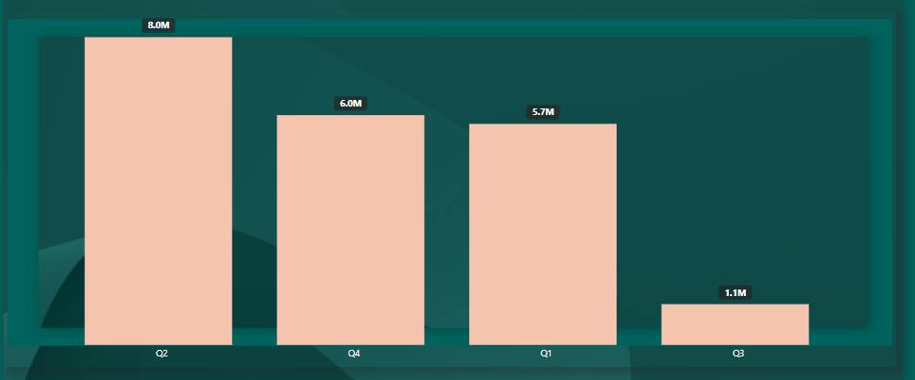
8. In which quarter of 2020, got the maximum total_sold_quantity? The final output contains these fields sorted by the total_sold_quantity, Quarter total_sold_quantity
CREATE DEFINER=`root`@`localhost` FUNCTION `get_quarter`
(calendar_date date )
returns varchar(2) CHARSET utf8mb4
DETERMINISTIC
BEGIN
DECLARE
m tinyint;
DECLARE qtr VARCHAR(2);
SET m= month(calendar_date);
CASE WHEN m IN(8,9,10)THEN S
ET qtr="Q1";
WHEN m IN(11,12,1)THEN SET qtr="Q2";
WHEN m IN(1,3,4)THEN SET qtr="Q3";
ELSE SET qtr="Q4";
END CASE;
RETURN qtr;
END
select get_quarter(f.date) as Quarter,round(sum(sold_quantity), 2) as `total sold quantity`
from fact_sales_monthly f
join dim_customer c on f.customer_code = c.customer_code
join fact_gross_price p on f.product_code = p.product_code and f.fiscal_year = p.fiscal_year
where f.fiscal_year='2020’
group by QUARTER
order by Quarter;

Slide 10
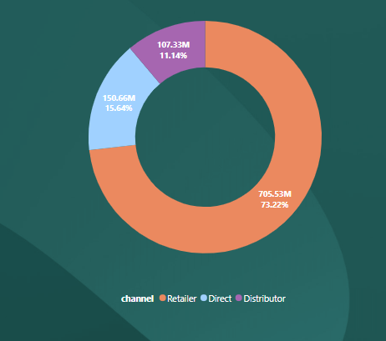
9. Which channel helped to bring more gross sales in the fiscal year 2021 and the percentage of contribution? The final output contains these fields, channel gross_sales_mln percentage
with channel_sales as
(
Select c.channel,
Round(sum(sold_quantity*gross_price)/1000000,2) as gross_sales_mln from dim_customer c
join fact_sales_monthly fs
on c.customer_code=fs.customer_code
join fact_gross_price gp
on fs.product_code=gp.product_code and year(fs.date)=gp.fiscal_year
where year(fs.date)=2021
group by channel),
sales as(select sum(gross_sales_mln) as total_sales
from channel_sales)
select cs.channel,concat(cs.gross_sales_mln,'M') as gross_sales_mln,concat(round((gross_sales_mln *100.0)/ ts.total_sales,2), '%') as percentage
from channel_sales as cs cross
join sales as ts
order by cs.gross_sales_mln desc;

Slide 11
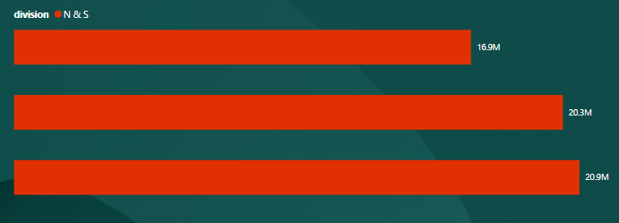
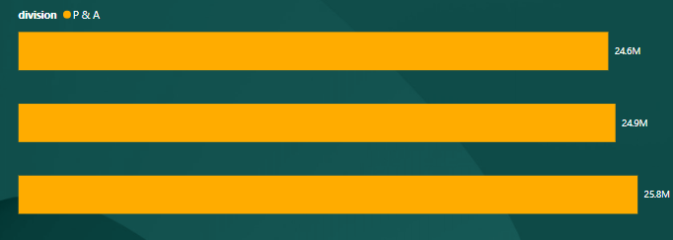
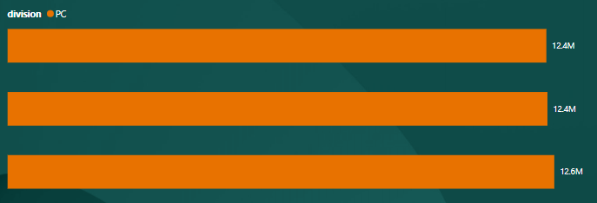
10. Get the Top 3 products in each division that have a high total_sold_quantity in the fiscal_year 2021? The final output contains these fields, division product_code
with sales_quantity as
(
select p.product_code,p.division,
p.product,round(sum(sold_quantity*gross_price),2) as total_sold_quantity
from fact_gross_price fp
join fact_sales_monthly fs
on fp.product_code=fs.product_code
join dim_product p on fs.product_code=p.product_code
where fs.fiscal_year='2021’
group by p.product_code,p.division,p.product ),
sales_rank as
(
select *, dense_rank() over( partition by division order by total_sold_quantity desc )
as rank_order
from sales_quantity)
select *
from sales_rank
where rank_order<= 3;

Slide 12
THANK YOU !

